Slide 1

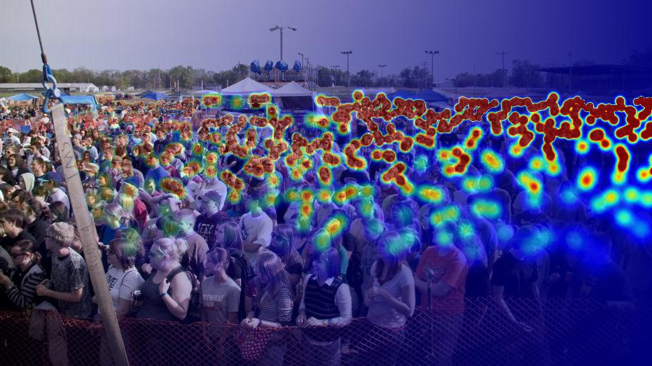

CROWD COUNTING
Aparajitha Sriram - 801169526
Chandan Mannem - 801165621
Monesa Thoguluva Janardhanan - 801167556
Sai Krishna Uddagiri - 801167439

Slide 2
INTRODUCTION
Crowd counting is the technique to count or give an estimate for the number of people in a large gathering from a picture or video like a surveillance feed.
We developed an algorithm that estimates the number of people in an image.
The main purpose of this project is analyzing and estimating the number of people who attend a session or a public event. This will help to understand what kind of sessions attract larger crowds and which do not.

Slide 3
Use Cases
Knowing the estimate of the number of people present in an area is of vital importance in the field of advertisements as it helps to get a count of an average number of eyeballs on each ad, like in a football match with tons of ads from sponsors. Another use case is in shops which will help them estimate their flow of customers and help in product placement.
It also plays a major role in disaster management and maintaining public safety like preventing overcrowding, stampedes and planning evacuation routes in case of emergencies. Some of the main challenges with crowd counting are occlusion (blockage or obstruction of view), clutter, irregular object distribution and varying illumination.

Slide 4
LITERATURE SURVEY
[1] is based on CNN and LSTM. High level features are extracted from pre-trained CNN. Then the features are used to regress the local counts with a LSTM structure which takes the spatial information into consideration. The final global count is obtained by a sum of the local patches.
[2] is based on Fully Convolutional Neural Network model (FCN). This paper talks about the different algorithms in crowd counting such as detection based counting, global regression based methods and density estimation that counts by integrating density map.
[3] presents an evaluation of different approaches to crowd counting. This paper compares holistic, local and histogram based approaches across five public datasets and contrasts it with regression models. The regression models evaluated were Gaussian Process Regression (GPR), linear regression, K Nearest Neighbour (KNN) and Neural Network (NN).

Slide 5
LITERATURE SURVEY
[4] proposes a network for Congested Scene Recognition called CSRNet to provide a data-driven and deep learning method that can understand highly congested scenes and provide an estimate of the crowd density by using high-quality density maps. The CSRNet model comprises of two major components: a convolutional neural network (CNN) as the front-end for 2D feature extraction and a dilated CNN for the back-end, which uses dilated kernels to deliver larger reception fields and to replace pooling operations.
Our project is based on the above reference paper. We will discuss about the approaches more in the upcoming slides.

Slide 6
DATASET EXPLANATION
We used two datasets
Shanghai-Tech Dataset [link]
Consists of highly congested scenes and sparse crowd scenes taken from the streets of Shanghai [5].
total of 1198 annotated images
combined total of 330,165 people
has two parts split into train & test set:
Part_A: 482 images
Part_B: 716 images
JHU-Crowd++ Dataset [link]
Consists of a diverse set of conditions and various geographical locations [6].
total of 4732 images
1.51 million annotations
samples in train, val and test split are 2272, 500, 1600 respectively.

Slide 7
OUR APPROACH
We started with generating density maps for the images.
We then trained the CSRNet model on the Shanghai dataset.
We tested it with the test images in the Shanghai dataset and validated our results.
We then tested it with the images from the JHU-Crowd dataset and validated our results.
We then compared our results from the two datasets.

Slide 8
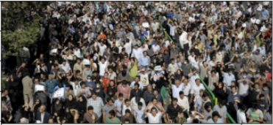
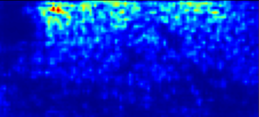
GENERATING DENSITY MAPS
The main approach to count the number of people is by estimating density.
The training data is processed to map every image with its corresponding density map.
Gaussian kernel convolution is used to obtain density map.
This processed data is use to train the model which outputs a density map which is used to predict the number of people in the image.

Slide 9
ABOUT CSRNET
The CSRNet model comprises of two major components: a convolutional neural network (CNN) as the front-end for 2D feature extraction and a dilated CNN for the back-end, which uses dilated kernels to deliver larger reception fields and to replace pooling operations.
Suppose we have an input x(m,n), a filter w(i,j) and the dilation rate r. The output y(m,n) will be:
Stochastic Gradient Descent is used to train the CSRNet as an end-to-end structure. During training the fixed learning rate is 1e-6.

Slide 10
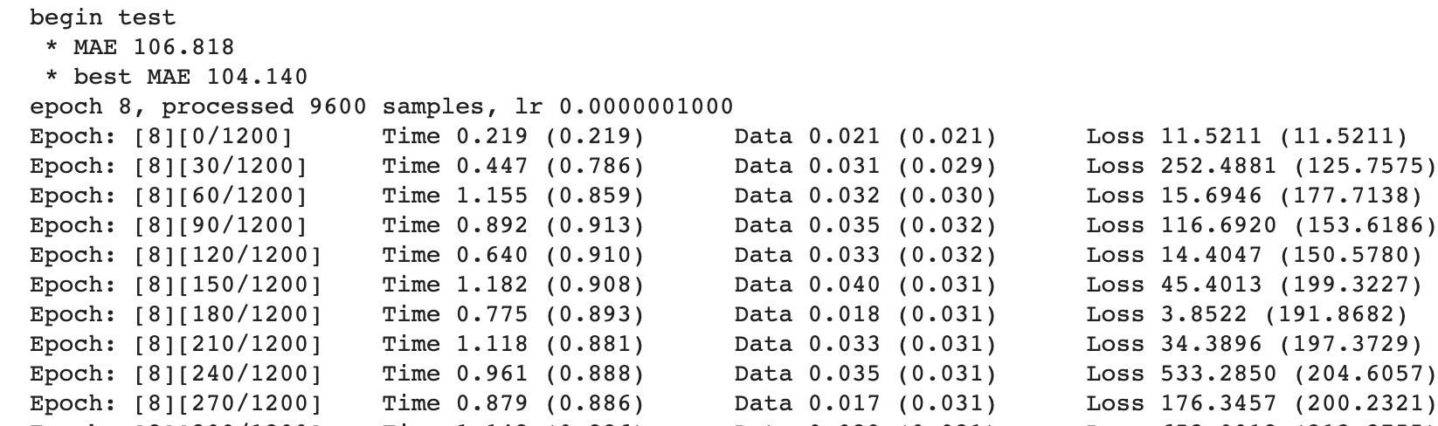
TRAINING THE MODEL
A density map for each image is generated as explained in the previous slides.Using the generated files, the model is trained using for the 400 epochs with a learning Rate - 1e-7.

Slide 11
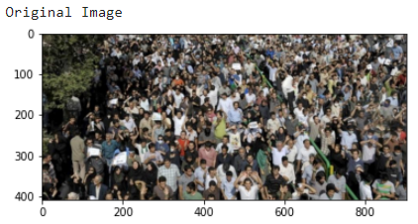
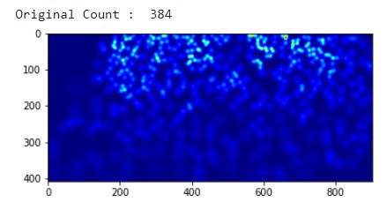
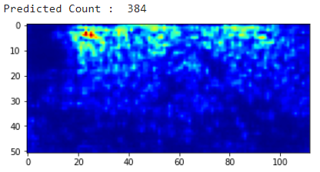
TESTING THE MODEL
The saved weights of the trained model are loaded to test the model on few images.
When an image is passed as an input to the model, the model outputs a set of density points pointing to each person in the image.
Using the trained weights we are predicting the count of crowd.
Here’s a sample test data being compared to the original data.

Slide 12
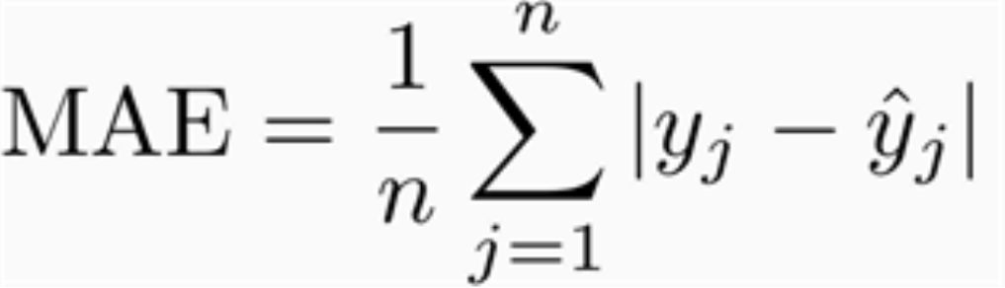
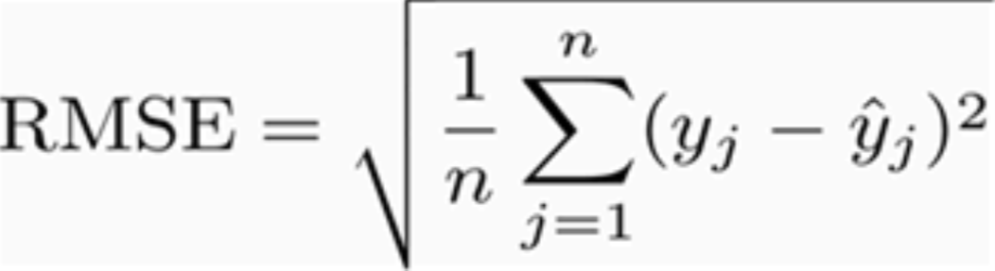
EVALUATION OF OUR MODEL
The Regression metrics Mean Absolute Error and Root Mean Square Error are used to calculate the efficiency of the model.
Mean Absolute Error (MAE):
Root Mean Square Error (RMSE):
MAE | 75.69
RMSE | 77.34

Slide 13
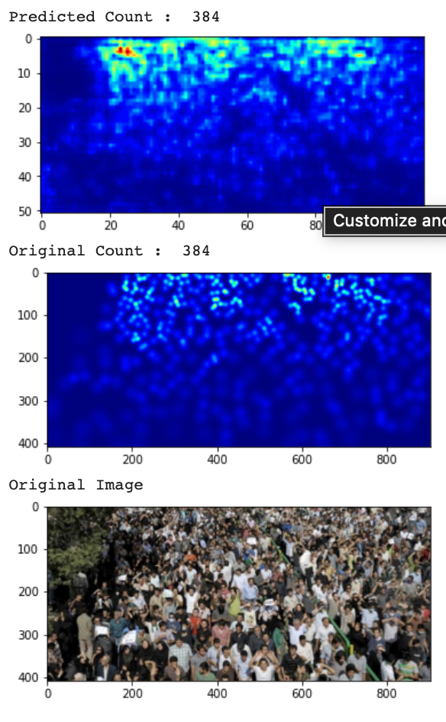
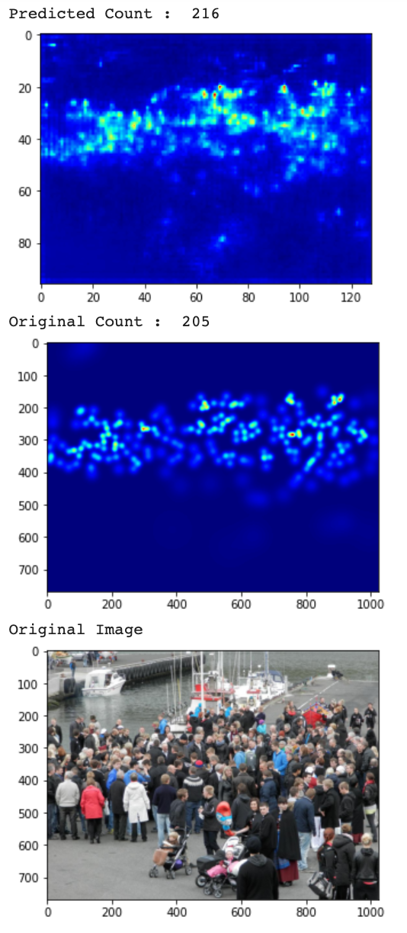
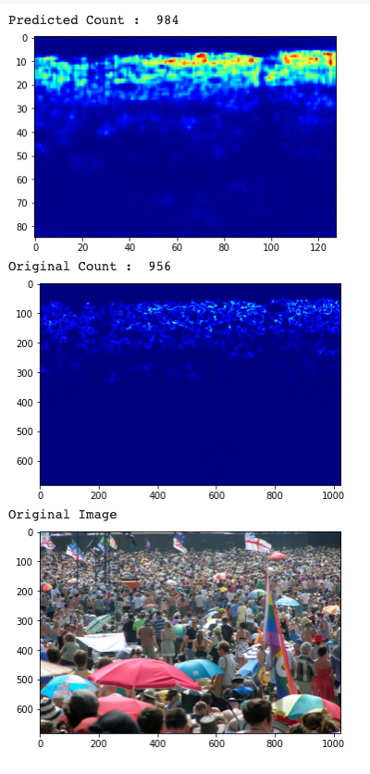
SAMPLE RESULTS WITH DATASET 1

Slide 14
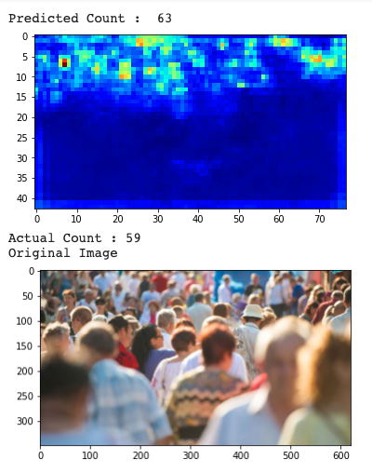
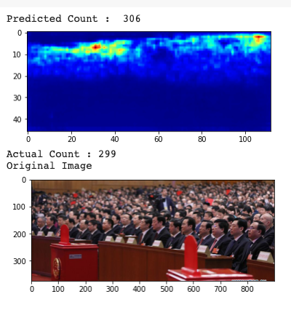
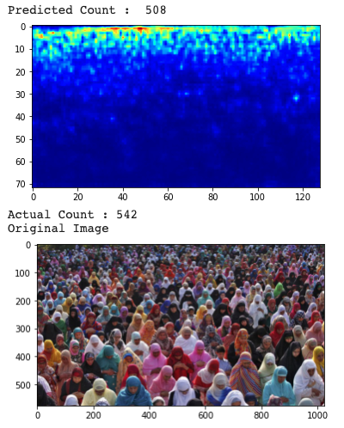
SAMPLE RESULTS WITH DATASET 2

Slide 15
OVERALL RESULT
Shanghai Dataset | JHU-Crowd Dataset
IMG_100 Predicted Count : 384 Actual Count : 384 | IMG_0004 Predicted Count : 63 Actual Count : 59
IMG_77 Predicted Count : 216 Actual Count : 205 | IMG_0006 Predicted Count : 306 Actual Count : 299
IMG_47 Predicted Count : 149 Actual Count : 119 | IMG_0132 Predicted Count : 508 Actual Count : 542
IMG_32 Predicted Count : 984 Actual Count : 956 | IMG_0211 Predicted Count : 1143 Actual Count : 1085

Slide 16
Challenges Faced
Generating the density map for the images as there are multiple images needed for training the model. This generation took us very long to run.
Training the model for 400 epoch. To get a good MAE score we had to train the model for multiple epoch which took us days to train the model.
Dealing with GPU running out of RAM space on Colab

Slide 17

Team Members Contribution
Tasks | Aparajitha | Monesa | Sai Krishna | Chandan
Literature Survey
Finding Dataset - 1 [Jhu]
Finding Dataset - 2 [Shanghai]
Generating Density Maps
Research about CSRNet
Training the model
Evaluation of the model
Results Analysis / Testing the model

Slide 18
REFERENCES
[1] Yao, Haiyan, et al. "Deep spatial regression model for image crowd counting." arXiv
preprint arXiv:1710.09757 (2017).
[2] J. Wang, L. Wang and F. Yang, "Counting Crowd with Fully Convolutional Networks,"
2017 2nd International Conference on Multimedia and Image Processing (ICMIP),
Wuhan, 2017, pp. 210-214, doi: 10.1109/ICMIP.2017.25.
[3] Ryan, David, et al. "An evaluation of crowd counting methods, features and
regression models." Computer Vision and Image Understanding 130 (2015): 1-17.
[4] Li Yuhong, Xiaofan Zhang, and Deming Chen. "Csrnet: Dilated convolutional neural
networks for understanding the highly congested scenes."Proceedings of the IEEE
conference on computer vision and pattern recognition.” 2018.
[5] Cong Zhang, Hongsheng Li, Xiaogang Wang, and Xiaokang Yang. Cross-scene
crowd counting via deep convolutional neural networks. In Proceedings of the IEEE
Conference on Computer Vision and Pattern Recognition, pages 833–841, 2015.

Slide 19
REFERENCES
[6] @article{sindagi2020jhu-crowd++,
title={JHU-CROWD++: Large-Scale Crowd Counting Dataset and A Benchmark Method},
author={Sindagi, Vishwanath A and Yasarla, Rajeev and Patel, Vishal M},
journal={Technical Report},
year={2020}
}

